Slide 1
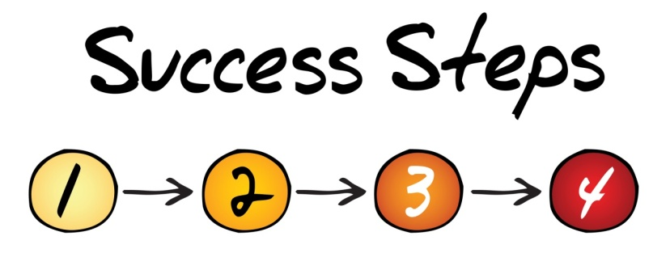
Initiating a Trade
4 Steps to Initiating a New Trade:
Check Liquidity
Check Skewness
Check Upcoming Major Events
Check Out VIX

Slide 2

Step One: Check Liquidity
Bid/Ask spread
Volume
Open Interest
Average Daily Volume in Underlying Value (UV)

Slide 3
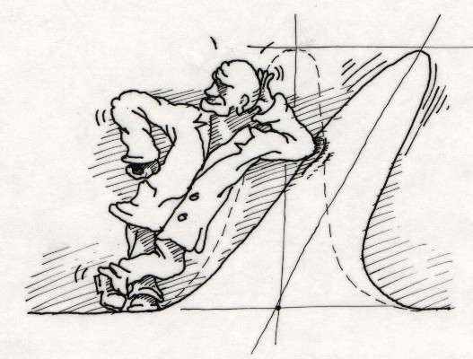
Step Two: Look at the Skewness
Compare prices of out-of-the-money (OTM) puts and calls
Look at the implied volatility (IVOL) of all of everything on the options chain

Slide 4

Step Three: Check for Major Events
Key Events to be Aware of:
Quarterly earnings report
USDA report
FDA announcement
Ex- Dividend date

Slide 5

Step Four: Check the VIX
Look at the spot CBOE Volatility Index (VIX)
Look at the VIX futures
Compare IVOL in potential trade to the VIX

Slide 6
Strategy of the Week
Short Strangle

Slide 7
Short Puts
Sell 20 GILD Nov 100 puts @ 2.37
Maximum Profit 2.37 ($4,740)@ 100 or higher
Breakeven Point 97.63
Maximum Loss $185,260 @ zero

Slide 8
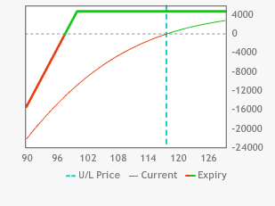
Short Puts

Slide 9
Short Calls
Sell 20 GILD Nov 135 calls @ 2.34
Maximum Profit 2.34 ($4,680)@ 135 or lower
Breakeven Point 137.34
Maximum Loss unlimited

Slide 10
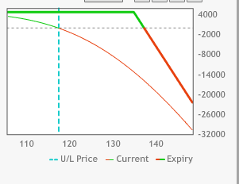
Short Calls

Slide 11
Short Strangle
Combine GILD short calls and short puts positions
Max Profit $9,420 from 100 through 135
Maximum downside loss $180,580 @ zero
Maximum upside loss unlimited
UBEP 139.71
DBEP 95.29
Short Strangle benefits from drop in IVOL
Short Strangle hurt by rise in IVOL

Slide 12
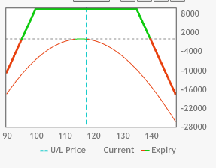
Short Strangle

Slide 13
Q&A
Email your questions to
dan@optionthinker.com

